Slide 1
ENG GenAI Community
22th August 2025

Slide 2
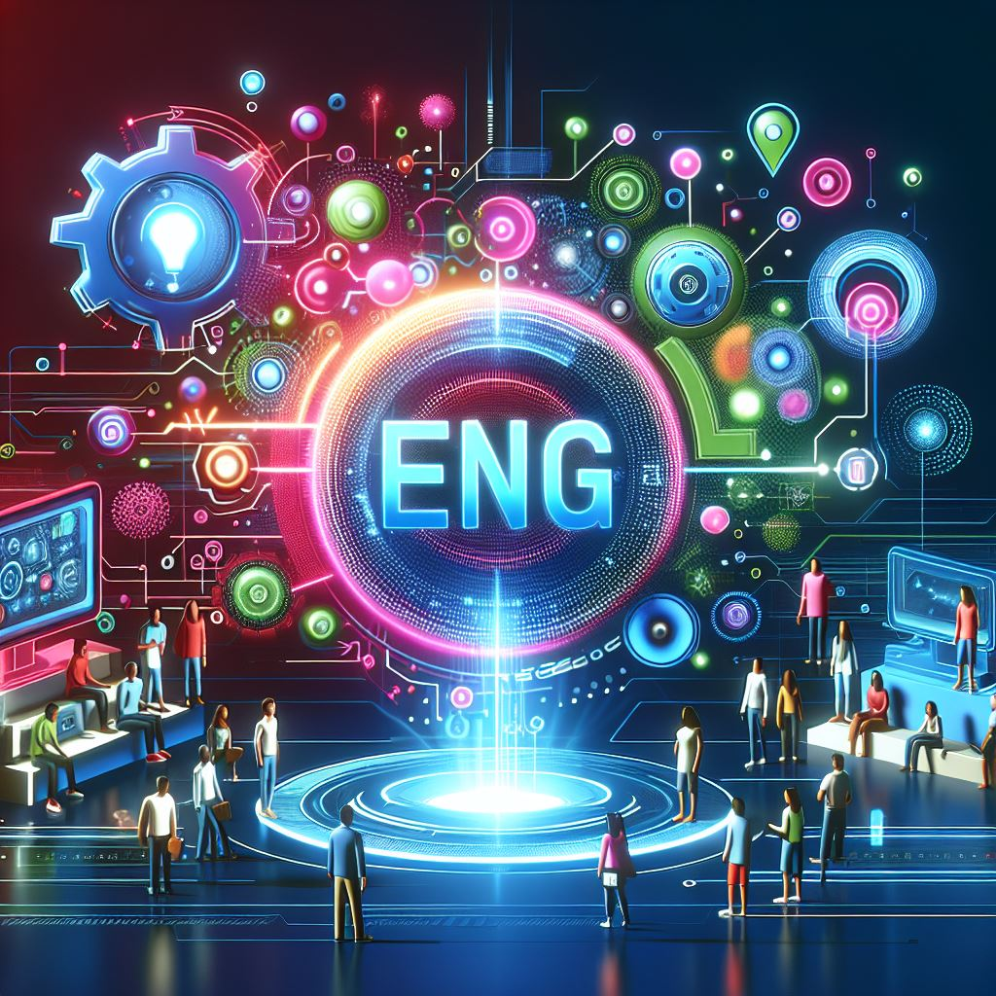




ENG GenAI Community
Session 4: February 28th, 2025
Practice-Session Translations:
Cracking the Code of Language and Computational Linguistics
Supercharge Your Translations with Siemens' AI Tools
Will AI Revolutionize Translators' Roles?
Effortlessly Translate Documents and Emails
Decode Cultural References Like a Pro
Practice-Session Excel:
Excel Formulas & Concepts from Copilot
Generate Formulas through description. Automate Tasks with VBA
Troubleshoot Formula Errors
Presented by:
Velina Ilieva
Karthekeyan M

Slide 3
Practice Session:
Translations – speak any language with Generative AI
Notes:
Hello!
My name is Velina Ilieva and today we will talk about computational linguistics and translations with Copilot.

Slide 4
Key terms
Language
Linguistics
Computational
linguistics
Combination of symbols, sounds and gestures according to specific rules.
Expression of thoughts verbally and in written form.
Scientific study of language and its structure.
Language form, language meaning, language in context
Interdisciplinary field that combines linguistics and computer science
Automating Language-Related Tasks
Enhancing Language Understanding
Facilitating Language Learning
Notes:
First let's lie down the foundations with a couple of key terms. The first one is language. It consists of symbols, sounds, and gestures that are combined according to specific rules to convey meaning. This is a very important characteristic which defines us as human beings. With language we express our thoughts verbally and in a written form.
Linguistics is the scientific study of language and its structure. It involves analyzing language form, language meaning, and language in context.
Computational linguistics is an interdisciplinary field that combines linguistics and computer science to study and develop algorithms and models for processing and understanding human language.
The main goal of computational linguistics is to enable computers to process and understand human language in a way that is both meaningful and useful. This involves developing algorithms and models that can interpret, generate, and manipulate natural language data.
Key objectives include:
Automating Language-Related Tasks: Such as translation, summarization, and information retrieval.
Enhancing Language Understanding: Enabling machines to understand context, sentiment, and nuances in human language.
Facilitating Language Learning: Using technology to support language education.

Slide 5

Computational linguistics and AI
Computational
linguistics
Natural Language Processing (NLP)
Machine Learning
Information Retrieval
Text Analytics
Notes:
AI and computational linguistics are closely intertwined fields that complement each other in many ways.
Artificial Intelligence (AI)
AI involves creating systems that can perform tasks that typically require human intelligence. These tasks include learning, reasoning, problem-solving, perception, and language understanding.
Computational Linguistics
Computational linguistics is the study of using computational methods to process and analyze human language. It combines elements of linguistics, computer science, and AI to understand and generate human language.
Interconnection
Natural Language Processing (NLP): This is a subfield of AI that focuses on the interaction between computers and human language. NLP uses computational linguistics techniques to enable machines to understand, interpret, and generate human language. Examples include language translation, sentiment analysis, and chatbots.
Machine Learning: AI systems often use machine learning algorithms to improve their language processing capabilities. Computational linguistics provides the data and models needed to train these algorithms. For instance, large corpora of text are used to train language models like GPT-4.
Information Retrieval: AI systems use computational linguistics to improve search engines and information retrieval systems. Techniques like keyword extraction, topic modeling, and semantic search help in retrieving relevant information from large datasets.
Text Analytics: AI leverages computational linguistics for text analytics, which involves extracting meaningful information from text data. This includes tasks like named entity recognition, summarization, and text classification.
In essence, computational linguistics provides the theoretical foundation and practical tools that enable AI systems to process and understand human language, making them more effective and user-friendly.

Slide 6



AI and translations
Microsoft Copilot - https://copilot.microsoft.com/
Siemens GPT - https://siemens.sharepoint.com/sites/siemensgpt
Siemens Translation Service - https://translation.siemens.cloud/translation
Duolingo – AI powered language learning app - https://www.duolingo.com/
Notes:
AI has numerous applications in linguistics, enhancing our ability to understand, process, and generate human language. Here are some key applications:
1. Machine Translation
AI-powered systems like Copilot, Siemens Translation Service use deep learning models to translate text from one language to another, improving accuracy and fluency over time.
10. Language Learning
AI-powered language learning apps like Duolingo provide personalized lessons, practice exercises, and feedback to help users learn new languages more effectively.

Slide 7





How will AI impact the future of the translators?
Enhanced Efficiency and Productivity
Improved Accuracy
Support for Complex Tasks
New Roles for Translators
Cost-Effectiveness
Notes:
AI is significantly transforming the field of translation, and its impact on the future of translators is multifaceted. Here are some key points to consider:
1. Increased Efficiency
AI-powered translation tools, such as neural machine translation (NMT) systems like DeepL and Google Translate, can process large volumes of text quickly and accurately. This allows translators to focus on more complex and nuanced aspects of translation, improving overall efficiency.
2. Enhanced Accuracy
AI systems are continuously improving in terms of accuracy and context understanding. They can handle idiomatic expressions, cultural nuances, and specialized terminology better than ever before, reducing the likelihood of errors in translations.
3. Cost Reduction
Automated translation tools can significantly reduce the cost of translation services. Businesses can use AI to handle routine translations, reserving human translators for high-stakes or highly specialized content.
4. New Roles for Translators
While AI can handle many translation tasks, human translators are still essential for ensuring quality and accuracy. Translators may take on roles such as post-editing machine translations, managing translation projects, and providing cultural insights that AI cannot fully replicate2.
In summary, while AI is revolutionizing the translation industry, human translators will remain indispensable for their expertise, cultural understanding, and ability to ensure the highest quality translations. The future will likely see a blend of AI and human collaboration, enhancing the capabilities and efficiency of translation services.

Slide 8

Let's practice! E-Mail translations with Copilot!
Notes:
Prompt 1 – You are part of an IT support team and you wish to send a downtime letter to the customers in which you explain that on Saturday between 12:00 CEST and 16:00 CEST there will be maintenance on the production environment. You have to write this e-mail in English and German.
Prompt 2 – You have just deployed a project from Denmark. The project manager wants to have from now on all onboardings letters for the customers to be translated in Dannish. In the letter you have to include a short greeting, ask the customer to retain the email which has his unique user access, his username, how to change his password and how to log in to the system.

Slide 9

Let's practice! Translation of documents with Copilot
Notes:
Prompt 1 – You need help with configuring FS20 devices and a fellow colleague from Sweden sends you a tutorial, but it is in Swedish. Upload the file and ask Copilot to translate it and summarize it.
Prompt 2 – You have written in English a guide for the customers about OpenID. After a careful review from the country responsible project managers you are asked by the colleagues from Italy and Norway to translate it in their respective languages. You ask Copilot to help you.

Slide 10
Do it yourself

Slide 11

Lets' practice! Cultural context
Ask Copilot to write you a wish to your colleagues for Easter in a language of your choice.
Have Copilot translate the following idioms into your language:
Break the ice
Let the cat out of the bag
Piece of cake
Once in a blue moon
Cut to the chase
The best of both worlds
Beat around the bush
A blessing in disguise
Too many cooks spoil the broth

Slide 12

Practice-Session:
GenAI: The Excel Game-Changer

Slide 13

Explanation of Excel Formulas & Concepts from Copilot

Slide 14


Generate Formulas from Description
Include details like cell references to generate formulas that don’t require additional modification
Provide additional context or background information whenever possible
Regenerate the responses to test and compare options (Copilot may not provide the optimal solution)

Slide 15

Automate Tasks with VBA
Be as clear and specific as possible
Provide details like tables, field names and file paths to generate code that doesn’t require additional modification
Ask for step-by-step instructions or code explanations, especially if you aren’t familiar with Visual Basic

Slide 16

Troubleshoot Formula Errors
Can you tell me how to fix it?
= LEN(TRIM(D2))- LEN(SUBSTITUTE(TRIM(D2),” ”,””)+1)
Include the full formula in the prompt, along with any additional context
Provide specific details like cell references and error types
Regenerate the responses to test and compare options (Copilot may not immediately identify the error or provide the optimal solution)

Slide 17
Q&A

Slide 18

Do you want to show your fellow Engineering colleagues around the world what cool things you are doing with Generative AI?
Of course you want to!
Be presenter in one of our next sessions and pass the GenAI spark to our team!

